Slide 1
Angular Topics
Class Binding
Style Binding
Event Binding

Slide 2
Class Binding
It is one way data binding.
Class binding is really useful request it allows you to dynamically add or remove classes through HTML elements.
Based on certain user interactions or state of your application you can change the classes being applied by changing the properties in your component class.
For applying multiple classes to the element is ngClass.

Slide 3
Style Binding
In angular style binding is used to apply Inline styles to HTML elements.
Style binding is similar to class binding.
For applying multiple styles to the element is ngStyle

Slide 4
Event Binding
In Angular, event binding is used to handle the events raised from the DOM like button click, mouse move etc.
When the DOM event happens (eg. click, change, keyup), it calls the specified method in the component.
It is one way data binding from HTML Template to Class.

Slide 5
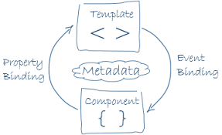

Slide 6
Thankyou
Presented By
Patnana Santosh Kumar

